Slide 1
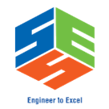



CSA0403-OPERATING SYSTEM
CO1 - ASSESSMENT 1
TECHNICAL PRESENTATION
The Evolution of Operating Systems: From Vacuum Tubes to the Cloud
GUIDED BY :
CHARLYN PUSHPA LATHA G
PRESENTED BY:
SIVA SUBRAMANIYAM B 192572089

Slide 2
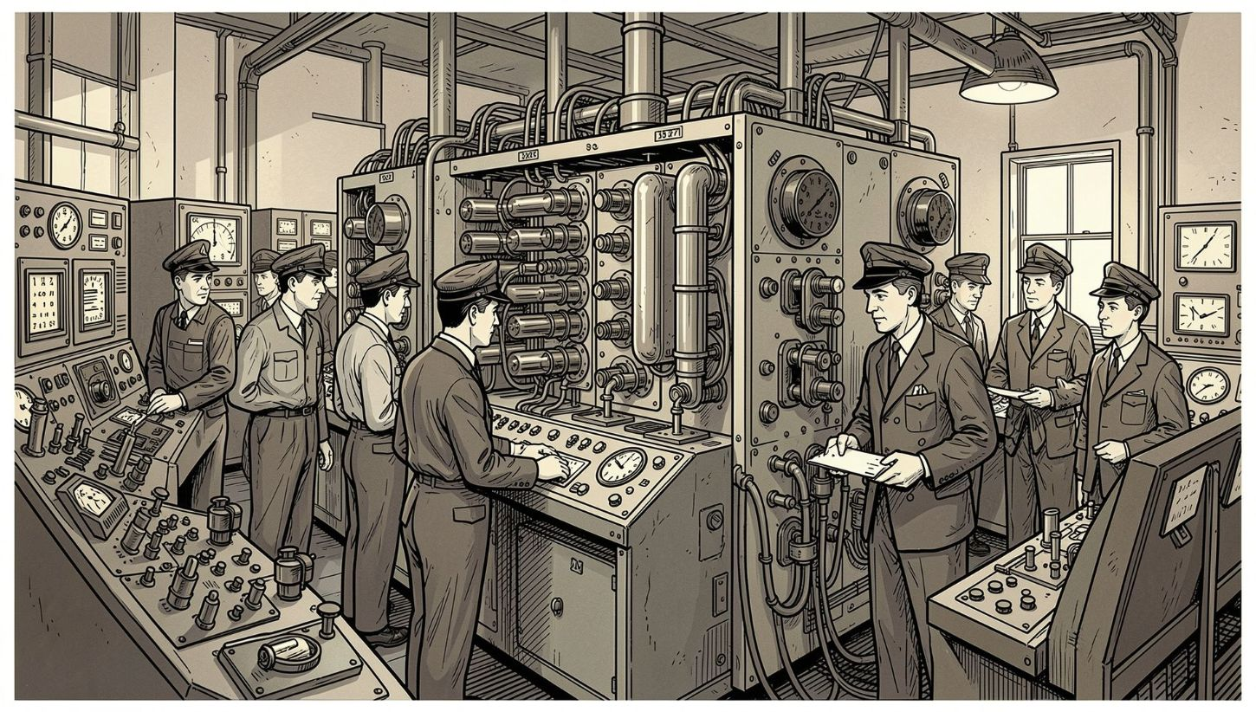

The Dawn of Computing (1945–1955)
What it looked like
Room-sized machines built from vacuum tubes and plugboards. Programming was physical: switches, rewiring and operator-controlled job sequences.
Key characteristics
No operating systems — a single operator ran one job at a time.
Extremely costly hardware with frequent failures and manual recovery.
Software and hardware were tightly coupled; every program expected a pristine machine state.
Foundations: These constraints motivated later automation and scheduling features.

Slide 3

Batch Processing to Time‑Sharing
(1955–1980)
Major advances
Batch
Time‑sharing
Transistors replaced vacuum tubes — more reliable and compact hardware.
Batch systems queued jobs to reduce idle CPU time; operators submitted job decks.
Multiprogramming and time‑sharing introduced scheduling, virtual memory and protection, allowing concurrent jobs and multiple users.
Job decks run sequentially
Many interactive users share CPU
Multiprogramming
Overlap CPU and I/O tasks
Why it mattered
Visual summary of how systems evolved to use scarce CPU time more efficiently and enable interactive use.
These innovations created the first true operating-system services: memory management, process scheduling and hardware abstraction — the building blocks of modern OS design.

Slide 4
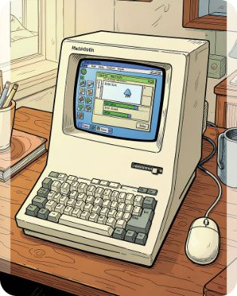
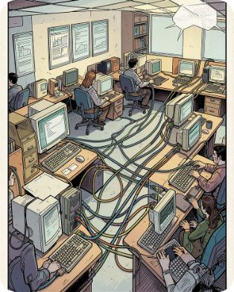
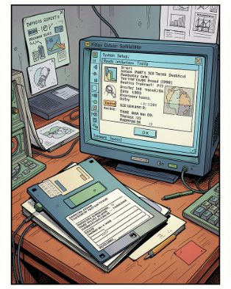
The Personal and Distributed Revolution (1980–2000)
Graphical Interfaces
Networking & Standards
Expanded OS Roles
GUIs made computing accessible to non‑specialists. Windowing, icons and mouse input shifted OS design toward responsiveness and usability.
Standard protocols (TCP/IP) enabled distributed computing. Operating systems integrated networking stacks, remote file access and basic security models.
File systems, multitasking, device drivers and user accounts matured — OSes became platforms for diverse applications across personal and enterprise use.

Slide 5
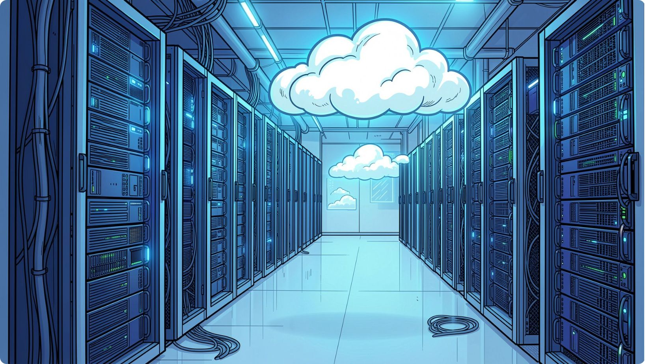

Ubiquity, Cloud and the Future (2000–Today)
Mobile & Embedded
Mobile OSes (Android, iOS) prioritise power efficiency, real‑time responsiveness and specialised drivers for sensors and radios.
Cloud & Virtualisation
Operating systems evolved into lightweight hypervisors, container runtimes and orchestration platforms that abstract hardware across global data centres.
Today’s role
Invisible foundation: OS and middleware now seamlessly manage resources for billions of devices.
Security and isolation are first‑class concerns: sandboxing, permissions and secure boot are standard.
Edge and serverless computing continue to reshape where and how OS services run.
Takeaway: From manual control to distributed automation, the OS continually abstracts complexity to let people and services focus on higher‑level problems.

